Slide 1

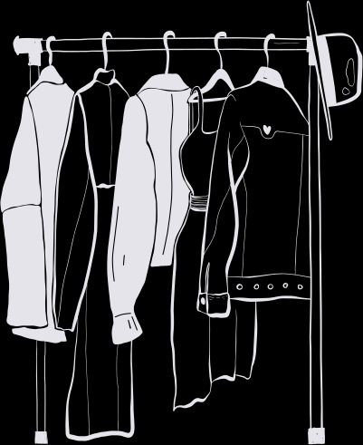





WEATHER WEAR
Presented By Team - 3
Bad Ideas

Slide 2


AGENDA
1
Team Members Roles and Responsibilities.
7
Technologies
13
Metrics
Improvements made from Professor Feedback.
14
Retrospective
2
8
Algorithms
15
Sprint 3
3
Project Description.
9
Diagrams and Recap
16
Project Demo
Team Working Agreement.
10
4
Product backlog
8
17
Github Link
5
Personas
11
Test Cases
18
Live Application Demo
6
6
MVP
12
Stories Completed

Slide 3

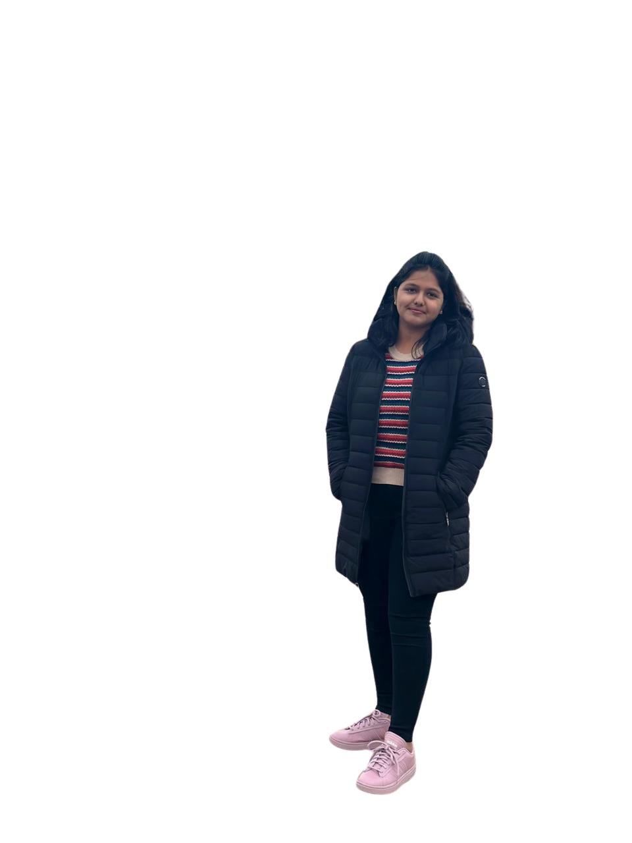
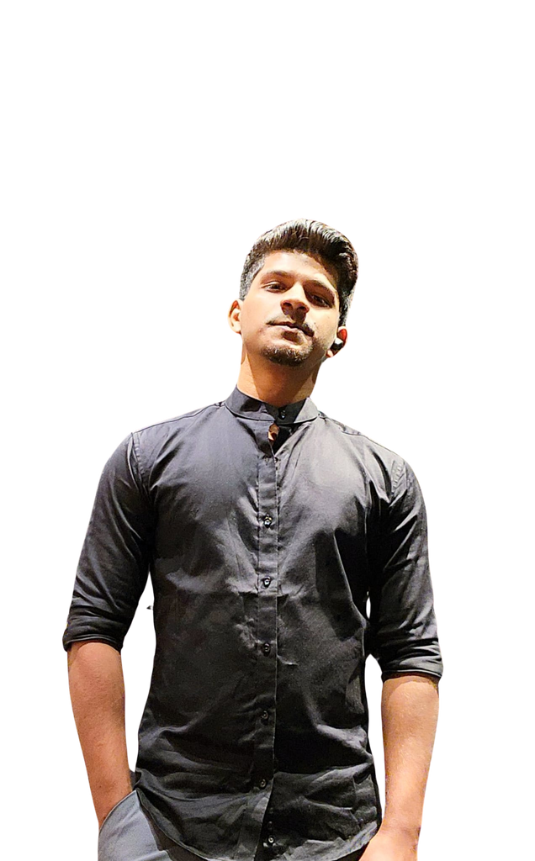
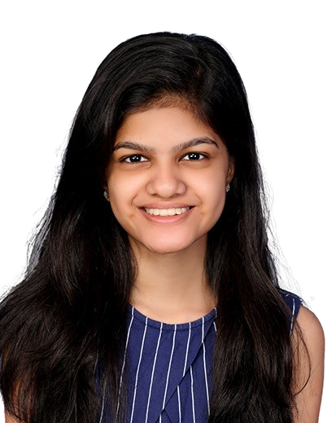

THIS IS OUR TEAM
Helloween James
Gracia Betty Jebaraj Daniel
Tejaswini Kandyala
Project Manager & Machine Learning Engineer
Frontend Developer
Frontend Developer & UI/UX Designer

Slide 4
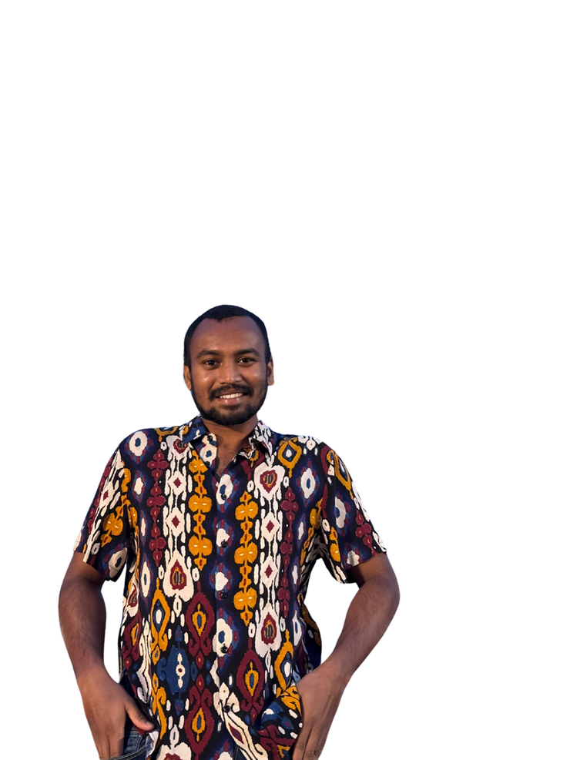
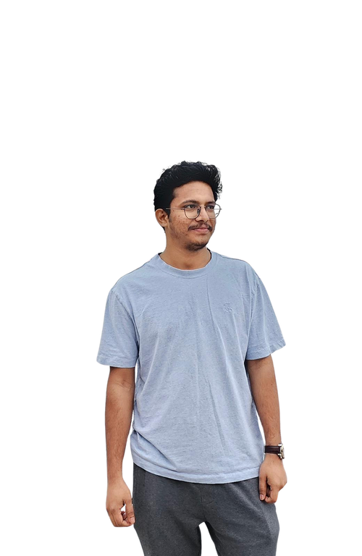
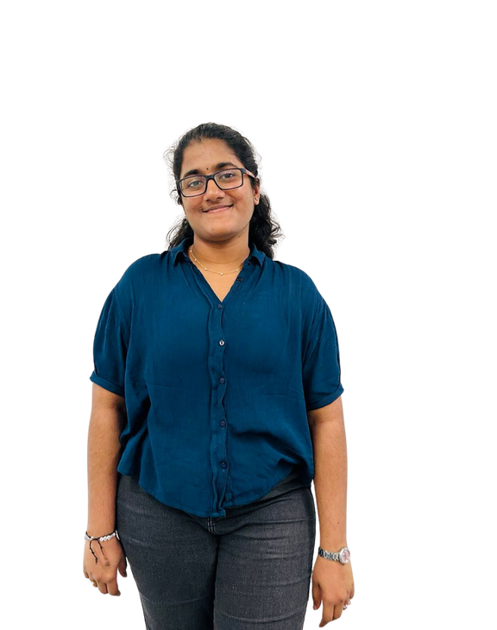
THIS IS OUR TEAM
Bharadwaj Reddy Asireddy
Mohith Durga Srinivas Tripuramallu
Sai Rajeswari Ghanta
Backend Developer & UI/UX Designer
Quality Assurance Tester
Backend Developer

Slide 5

Improvements made from professor feedback
Using specific name for the user stories.
Aligning the diagrams order.
Adding proper user id and test case id.
Addition of user benefits.
Addition of “So ..” in the user stories.

Slide 6
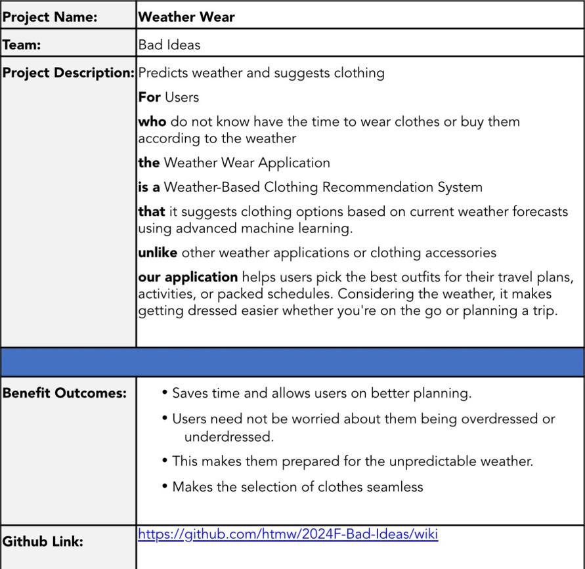
PROJECT DESCRIPTION

Slide 7

TEAM AGREEMENT
1. Team Information
· Project Title: Weather Wear
· Team Name: Bad Ideas
· Team Members and Roles :
Helloween James – Project Manager & Machine learning engineer
Gracia Betty Jebaraj Daniel – Front-end developer & UI/UX Designer
Tejaswini Kandyala – Front-end developer
Mohith Durga Srinivas Tripuramallu – Back-end Developer
Bharadwaj Reddy Asireddy - Back-end Developer & UI/UX Designer
Sai Rajeswari Ghanta - Quality Assurance (QA) Tester
2. Meetings and Communication
We will meet twice a week and we shall use what’s app, email, outlook and Zoom as our communication for any updates and response should be within 2-3hrs.
3. Work Distribution
Everyone in the team agrees to share the work equally and if any member fells overwhelmed, we will redistribute the tasks.

Slide 8
TEAM AGREEMENT
4. Conflict Resolution
· If we have any sort of disagreement in the tasks, we’ll talk it through vote.
· If the conflict cannot be resolved internally, we will reach professor for an advice
5. Deadlines
· We will set deadlines for each task and everyone agrees to stick to them and if someone can’t meet a deadline, they should inform the team in advance.
· We agree to submit everything on time, with everyone’s contribution.
6. Signatures
· Gracia Betty Jebaraj Daniel
· Tejaswini Kandyala
· Helloween James
· Mohith Durga Srinivas Tripuramallu
· Bharadwaj Reddy Asireddy
· Sai Rajeswari Ghanta

Slide 9

PERSONAS

Slide 10
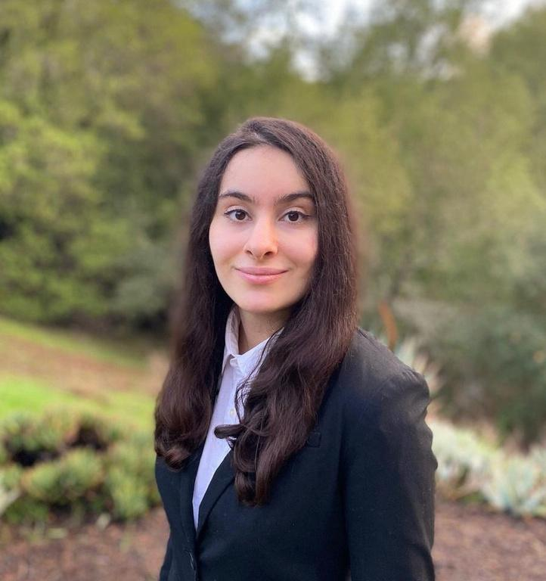
HANNAH
This is Hannah, Age 28. She stays in New York City, NY and she is Product Manager.
Life Style: She commutes everydays and she meets a lot of clients.
Weather and Clothing: NYC weather is totally unpredictable as it can rain, be sunny or be cold anytime. She likes wearing formal clothes.
Technology usage: She loves trying out new apps.
She is busy person and always wears uncomfortable dress which does not align well with weather, so she needs something which can set her to wear clothes which doesn't waste her time.

Slide 11

JASON
This is Jason, Age 34. He stays in Seattle, WA, and he is a Software Engineer.
Life Style: He commutes to the office twice a week and enjoys biking when the weather permits.
Weather and Clothing: Seattle's weather is unpredictable, with frequent rain and sudden changes. He prefers casual and comfortable clothing but often finds himself either underdressed for cold weather or overdressed when it warms up unexpectedly.
Technology usage: He is tech-savvy and enjoys trying out new apps to improve efficiency.
He frequently faces issue with choosing the right clothes due to the constant change in weather and he needs a solution that helps him dress appropriately for the day.

Slide 12

ANANYA
This is Ananya, Age 22. She stays in Mumbai, India, and she is a College Student.
Life Style: She walks around campus a lot, balancing her classes, internships, and extracurricular activities.
Weather and Clothing: Mumbai's weather can be unpredictable, with sudden rain showers or humid heat. She likes trendy, comfortable clothes but struggles to dress appropriately when the weather changes quickly.
Technology usage: She uses multiple apps to manage her busy schedule and lifestyle.
She often finds herself either drenched in rain or overheated due to sudden weather changes and needs something that will help her choose the right outfit for the day without wasting time.

Slide 13

Minimum Viable Product
Location-Based Weather Data: Fetch and display real-time weather.
Outfit Suggestions: Recommend outfits based on weather.
Future Outfit Planning: Plan outfits for future dates.
User Preferences: Customize outfit recommendations.
Responsive Design: Optimized for mobile and desktop.

Slide 14



TECHNOLOGIES
Frontend
Backend
Database
Next JS
Shadcn
Tailwind CSS
Flask
Open weather API
MongoDB

Slide 15
TECHNOLOGIES
Machine
Learning
Tools
Deployment
Figma
VSCode
Codespaces
Github
Postman
Vercel
AWS
Scikit Learn
Pytorch

Slide 16


ABOUT FRONTEND TECHNOLOGIES
So here next js is used for building the website because next js is one of the best frontend frameworks and with integration with shadcn and tailwind css, building minimalistic website easier.

Slide 17

ABOUT BACKEND TECHNOLOGIES
RapidAPI offers a variety of weather APIs that provide all the data you could need. These APIs are great for delivering accurate and up-to-date weather information.
For our project, we chose one of these weather APIs from RapidAPI to boost our data capabilities.

Slide 18

ABOUT DATABASE TECHNOLOGIES
MongoDB is one the best NoSQL database and as the application data can also be unstructured, this would be best option to choose it. This also have fast retrieval ( read operations) compared to SQL databases, so this is better choice for this application.

Slide 19

ABOUT DEPLOYMENT TECHNOLOGIES
Here, first vercel is used for deploying the frontend part of the application and aws is used for deploying backend and machine learning as well because NextJS works seamless in vercel, as vercel are the one who developed Next js.

Slide 20

ABOUT MACHINE LEARNING TECHNOLOGIES
So here scikit learning is primarily used for building the basic version of the machine learning algorithms and in later on stages, Pytorch is used for build even more accurate version of the machine learning which understands the weather even more better and predicts it well.

Slide 21

ABOUT TOOLS TECHNOLOGIES
Figma is mainly used for prototyping and design how the product looks like. VSCode is where actually the code is written. Codespaces is where the collaboration code is done, for pair programming. Github is where whole code is hosted. Postman is for testing the API endpoints.

Slide 22

ALGORITHMS
Predicting Weather
Random forest regressor
Used to predict weather conditions like temperature or humidity by learning patterns from historical weather data through decision trees that capture non-linear relationships.
LSTM
A recurrent neural network used to predict future weather by capturing long-term dependencies and patterns in sequential weather data over time.
Recommendation
KNN (k-nearest neighbours)
Used to recommend outfits by finding similar users (or outfits) based on user preferences and weather conditions, suggesting clothing choices that worked for users with similar profiles or conditions.

Slide 23
DIAGRAMS

Slide 24
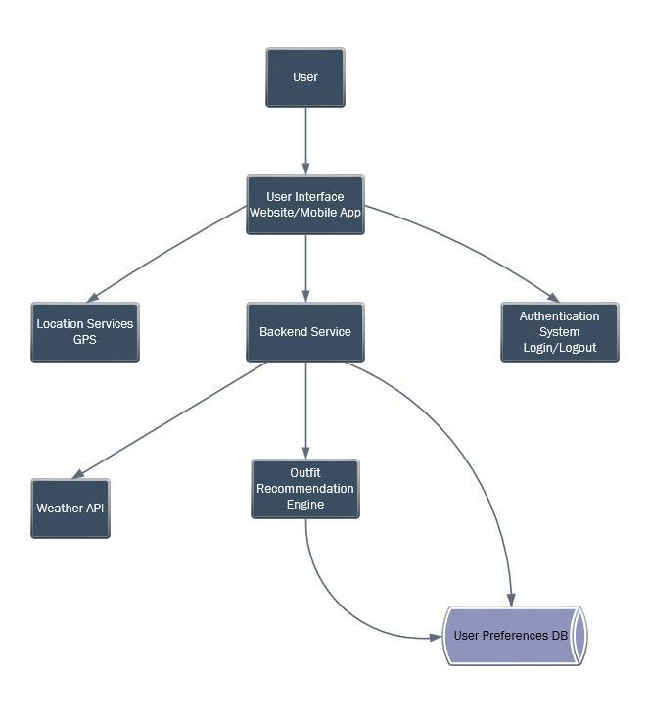
Architecture diagram

Slide 25
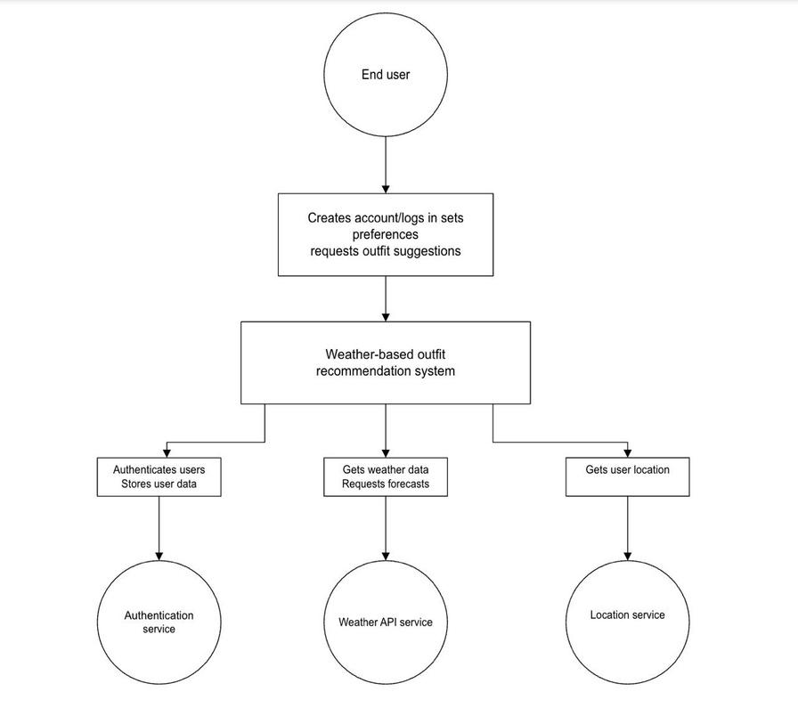
Context diagram

Slide 26
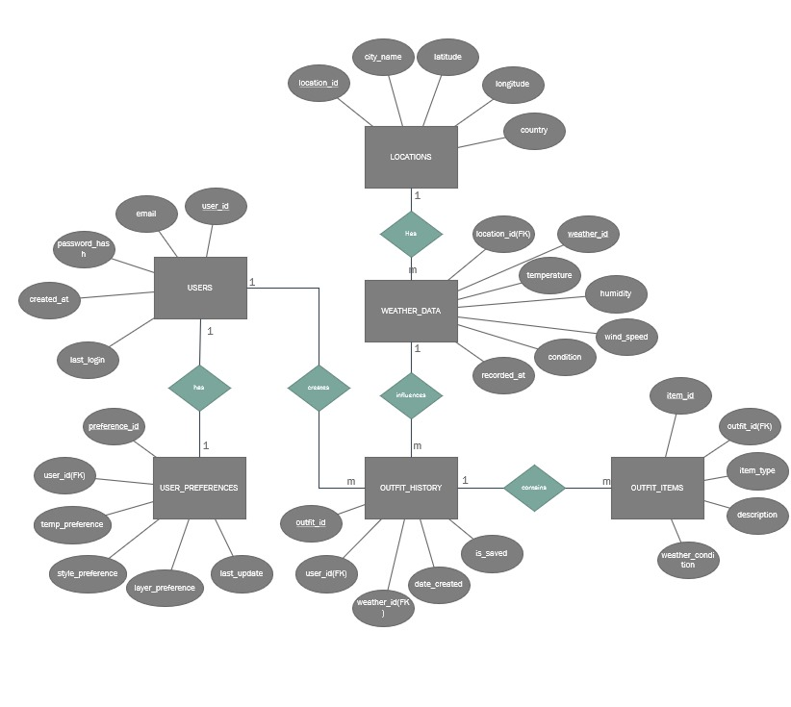
ER diagram

Slide 27
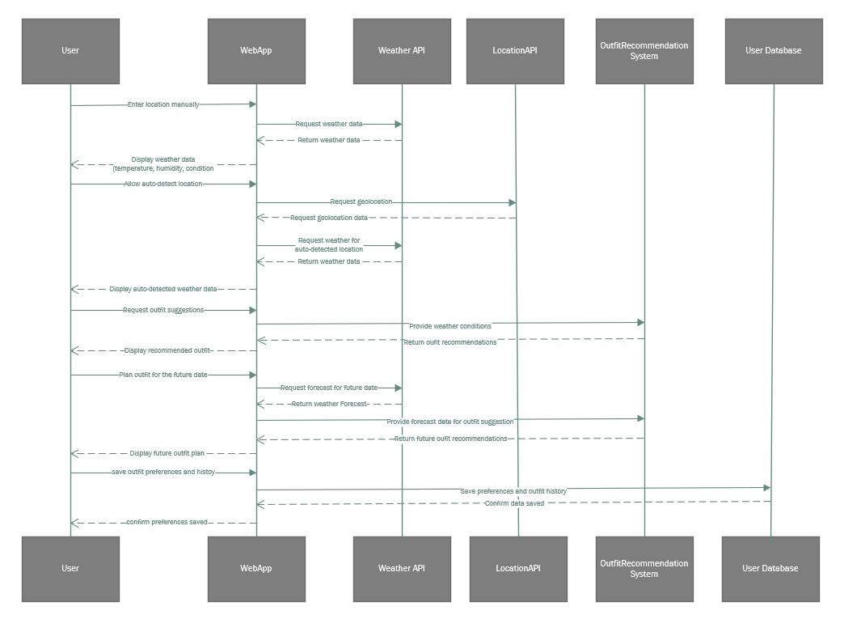
Sequence diagram

Slide 28
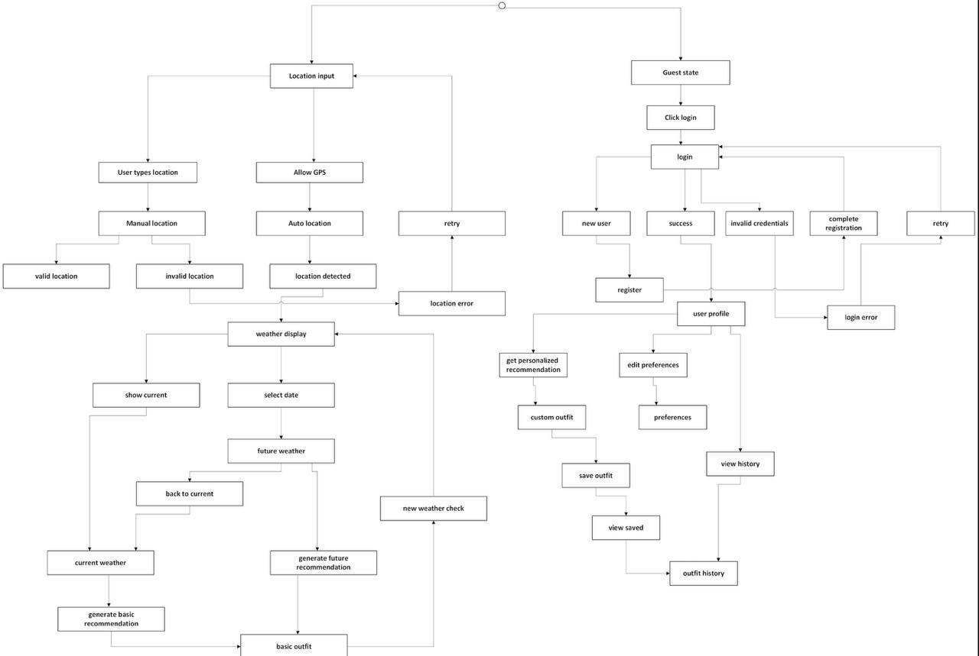
State Diagram

Slide 29
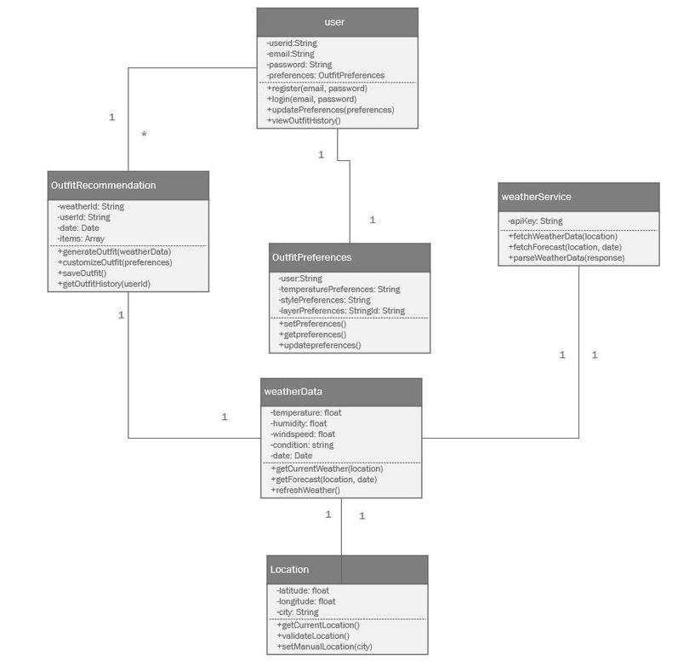
Class diagram

Slide 30
Sprint 1 Recap
In Sprint 1, we enabled real-time weather data input, Auto-detection of our location, a user-friendly display, and mobile responsiveness.
Integrating a weather API with error handling for accurate, accessible information.

Slide 31
Sprint 2 Recap
In Sprint 2, we enabled 5 day outfit planner based on weather for the detected location and preferences such as gender, style preference, formality level, temperature sensitivity and toggles for prioritizing rain and wind protection.

Slide 32
Product Backlog
Sprint | User Story ID | User Story | So That | User Benefit | Acceptance Criteria
Sprint 1 | US 1.1 | As a weather enthusiast, I want to input my current location to get real-time weather data. | I can view accurate weather information for my location. | Access real-time weather information for any chosen location. | 1. User can input location manually. 2. User can choose from predefined cities. 3. System displays temperature, humidity, and weather condition. 4. Graceful error handling for invalid locations.
Sprint 1 | US 1.2 | As a business professional, I want the system to detect my location automatically to quickly get weather info. | I can receive weather updates without inputting my location manually. | Save time by receiving instant, location-based weather updates. | 1. Option to enable location-based weather. 2. System requests geolocation permission. 3. Automatic weather data retrieval. 4. Graceful handling when permission is denied.
Sprint 1 | US 1.3 | As a traveler, I want to see basic weather details clearly on the homepage. | I can quickly check weather updates while on the go. | View essential weather info at a glance while on the go. | 1. Temperature, humidity, wind speed, and weather condition are displayed clearly. 2. Simple, user-friendly layout.

Slide 33
Product Backlog
Sprint | User Story ID | User Story | So That | User Benefit | Acceptance Criteria
Sprint 1 | US 1.4 | As a weather enthusiast, I want to refresh weather data manually. | I can ensure the weather data displayed is up-to-date. | Get up-to-date weather information whenever needed. | 1. Refresh button for manual data refresh. 2. Latest weather information displayed.
Sprint 1 | US 1.5 | As a business professional, I want the website to be responsive on mobile devices. | I can comfortably view weather information on any device. | Access weather information comfortably on any device. | 1. Responsive layout for desktop and mobile. 2. Weather data clearly visible on all devices.
Sprint 1 | TS 1.1 | As a UI/UX designer, I want a basic layout for weather data display. | Users can intuitively interact with the weather data. | Enable intuitive weather data interaction for users. | 1. Homepage with location input fields and refresh button. 2. Clear, organized weather data display.

Slide 34
Product Backlog
Sprint | User Story ID | User Story | So That | User Benefit | Acceptance Criteria
Sprint 1 | TS 1.2 | As a backend developer, I want to integrate a weather API to fetch real-time weather data. | Users receive reliable weather information. | Provide reliable and accurate weather data for users. | 1. Successful data retrieval from an external API. 2. Stable API integration. 3. Error handling for invalid locations.
Sprint 2 | US 2.1 | As a weather enthusiast, I want to receive an outfit suggestion based on current weather conditions. | I can dress appropriately for the weather. | Dress appropriately for the weather. | 1. Outfit suggestion for cold, warm, rainy, snowy, and windy conditions.
Sprint 2 | US 2.2 | As a traveler, I want to prepare an outfit for a future date or journey. | I can plan my wardrobe for upcoming trips. | Plan ahead for upcoming weather conditions. | 1. Future date input for weather forecasts. 2. Outfit suggestions based on future weather. 3. Time of day selection for accuracy.

Slide 35
Product Backlog
Sprint | User Story ID | User Story | So That | User Benefit | Acceptance Criteria
Sprint 2 | US 2.3 | As a business professional, I want to adjust outfit preferences based on my comfort level. | I can personalize clothing recommendations to my liking. | Personalize outfit suggestions to match my preferences. | 1. Set preferences for warmer or cooler outfits. 2. Outfit recommendations tailored to preferences.
Sprint 2 | US 2.4 | As a traveler, I want to receive clothing layer suggestions for cold weather. | I can prepare for extreme weather conditions. | Dress appropriately with layered clothing suggestions. | 1. Layered clothing suggestions for cold, rainy, and very cold conditions.
Sprint 2 | US 2.5 | As a business professional, I want to check weather and outfit recommendations for multiple days. | I can plan outfits for the week efficiently. | Plan outfits for multiple days in advance. | 1. Multi-day weather forecasts retrieval. 2. Outfit suggestions for selected dates.

Slide 36
Product Backlog
Sprint | User Story ID | User Story | So That | User Benefit | Acceptance Criteria
Sprint 2 | TS 2.1 | As a recommendation system developer, I want to implement a weather forecast-based recommendation system. | Users receive outfit suggestions based on future weather. | Offer accurate outfit planning based on future conditions. | 1. Integration of weather forecast data. 2. Accurate outfit recommendations based on forecasted weather.
Sprint 2 | TS 2.2 | As a UI developer, I want to build an interface for future date outfit planning and customization. | Users can easily plan and customize outfits. | Enable easy future planning and customization. | 1. UI for selecting future dates and customizing outfit preferences. 2. Seamless outfit planning experience.
Sprint 3 | US 3.1 | As a business professional, I want to create an account and log in to save my preferences and outfit history. | I can save outfit data for future reference. | Save outfit choices and preferences for convenience. | 1. Account creation with basic details. 2. Secure login/logout. 3. Saving and retrieval of outfit preferences and history.

Slide 37
Product Backlog
Sprint | User Story ID | User Story | So That | User Benefit | Acceptance Criteria
Sprint 3 | US 3.2 | As a weather enthusiast, I want to view previous outfit suggestions for future reference. | I can make informed clothing decisions based on past suggestions. | Review past outfits for similar weather conditions. | 1. View outfit suggestions based on past weather. 2. Save suggestions for specific dates/locations.
Sprint 3 | US 3.3 | As a traveler, I want to receive tailored outfit suggestions based on past choices and preferences. | I can receive recommendations that align with my habits. | Get more personalized recommendations over time. | 1. Personalized outfit suggestions based on past selections and weather data.
Sprint 3 | TS 3.1 | As a security-focused developer, I want to implement a simple user authentication system. | User data and preferences are secured. | Secure and easy user registration and login. | 1. Secure user registration and login system. 2. Storage of preferences and outfit history.

Slide 38
Product Backlog
Sprint | User Story ID | User Story | So That | User Benefit | Acceptance Criteria
Sprint 3 | TS 3.2 | As a UI/UX finisher, I want to finalize UI/UX improvements and make the website fully responsive. | Users enjoy a seamless and consistent experience across devices. | Ensure a smooth and consistent user experience. | 1. Enhanced UI/UX. 2. Full responsiveness on all devices.

Slide 39
Sprint 3 Backlog
Story ID | Story Points | User Story/Task Description | So That | Acceptance Criteria
TS2.2 | 8 | Carried Over: As a UI developer, I want to build an interface for future date outfit planning and customization. | I can easily plan and customize outfits for future dates. | 1. UI for selecting future dates and customizing outfit preferences. 2. Seamless outfit planning experience.
US3.1 | 8 | As a business professional, I want to create an account and log in to save my preferences and outfit history. | I can save and retrieve outfit preferences conveniently. | 1. Account creation with basic details. 2. Secure login/logout. 3. Saving and retrieval of outfit preferences and history.
US3.2 | 5 | As a weather enthusiast, I want to view previous outfit suggestions for future reference. | I can refer back to past outfit suggestions for similar weather conditions. | 1. View outfit suggestions based on past weather. 2. Save suggestions for specific dates/locations.
US3.3 | 8 | As a traveler, I want to receive tailored outfit suggestions based on past choices and preferences. | I can get personalized outfit recommendations that suit my style and past choices. | 1. Personalized outfit suggestions based on past selections and weather data.

Slide 40
Sprint 3 Backlog
Story ID | Story Points | User Story/Task Description | So That | Acceptance Criteria
TS3.1 | 5 | As a security-focused developer, I want to implement a simple user authentication system. | User accounts are secure, and preferences/history are safely stored. | 1. Secure user registration and login system. 2. Storage of preferences and outfit history.
TS3.2 | 8 | As a UI/UX finisher, I want to finalize UI/UX improvements and make the website fully responsive. | Users have a smooth and consistent experience across all devices. | 1. Enhanced UI/UX. 2. Full responsiveness on all devices.

Slide 41
Test Cases - 3
Test Case ID | Story ID | Test Case Description | Expected Result | Pass/Fail
TC_TS2.2_01 | TS2.2 | Verify that the user can select a future date for outfit planning. | Future date selection is functional and displays a date picker for user interaction. | Pass
TC_TS2.2_02 | TS2.2 | Verify that users can customize outfit preferences for a selected date. | Customization options are visible and allow users to modify preferences. | Pass
TC_US3.1_01 | US3.1 | Verify that users can create an account with valid details. | Account creation succeeds, and user data is stored securely. | Pass
TC_US3.1_02 | US3.1 | Verify secure login functionality. | Users can log in securely with their credentials and are redirected to their dashboard. | Pass
TC_US3.1_03 | US3.1 | Verify that preferences and outfit history can be retrieved after login. | User preferences and outfit history are displayed correctly on the dashboard. | Pass
TC_US3.2_01 | US3.2 | Verify that users can view previous outfit suggestions for specific dates. | Previous outfit suggestions are retrieved and displayed based on the selected date. | Pass
TC_US3.2_02 | US3.2 | Verify that outfit suggestions can be saved for specific dates. | Suggestions are successfully saved and retrievable for selected dates. | Pass

Slide 42
Test Cases - 3
Test Case ID | Story ID | Test Case Description | Expected Result | Pass/Fail
TC_US3.3_01 | US3.3 | Verify that tailored outfit suggestions are generated based on past data. | Suggestions are customized using past user data and are relevant to weather conditions and preferences. | Pass
TC_TS3.1_01 | TS3.1 | Verify secure user registration functionality. | Users can register securely, and their credentials are encrypted and stored safely. | Pass
TC_TS3.1_02 | TS3.1 | Verify secure user login functionality. | Login works seamlessly, and user data remains confidential and protected. | Pass
TC_TS3.2_01 | TS3.2 | Verify that the website layout is responsive across all devices. | Website layout adjusts seamlessly for different screen sizes (desktop, tablet, and mobile). | Pass
TC_TS3.2_02 | TS3.2 | Verify that UI/UX improvements enhance usability. | Enhanced UI/UX provides intuitive navigation and a visually appealing interface. | Pass

Slide 43
Stories Completed
Story ID | User Story/Task Description | Story Points | So That
TS2.2 | As a UI developer, I want to build an interface for future date outfit planning and customization. | 8 | I can easily plan and customize outfits for future dates.
US3.1 | As a business professional, I want to create an account and log in to save my preferences and outfit history. | 8 | I can save and retrieve outfit preferences conveniently.
US3.2 | As a weather enthusiast, I want to view previous outfit suggestions for future reference. | 5 | I can refer back to past outfit suggestions for similar weather conditions.
US3.3 | As a traveler, I want to receive tailored outfit suggestions based on past choices and preferences. | 8 | I can get personalized outfit recommendations that suit my style and past choices.
TS3.1 | As a security-focused developer, I want to implement a simple user authentication system. | 5 | User accounts are secure, and preferences/history are safely stored.
TS3.2 | As a UI/UX finisher, I want to finalize UI/UX improvements and make the website fully responsive. | 8 | Users have a smooth and consistent experience across all devices.
TOTAL: |  | 42 Story Points

Slide 44
Team Velocity (Sprint 3)
Team Velocity (Sprint 3)
Total Story Points Committed: 42 points
Total Story Points Completed: 42 points

Slide 45
Team’s Historical Velocity (Average)
Sprint 1 Velocity: 26 points
Sprint 2 Velocity: 42 points
Sprint 3 Velocity: 42 points
Result:
Team’s Historical Velocity = (26 + 42 + 42) / 3 = 110 / 3 = 36.67 story points

Slide 46
Completed/Committed Ratio – Sprint 3
Sprint 3 Metrics:
Total Story Points Committed: 42 points
Total Story Points Completed: 42 points
Completed/Committed Ratio = (42 / 42) × 100 = 100%

Slide 47
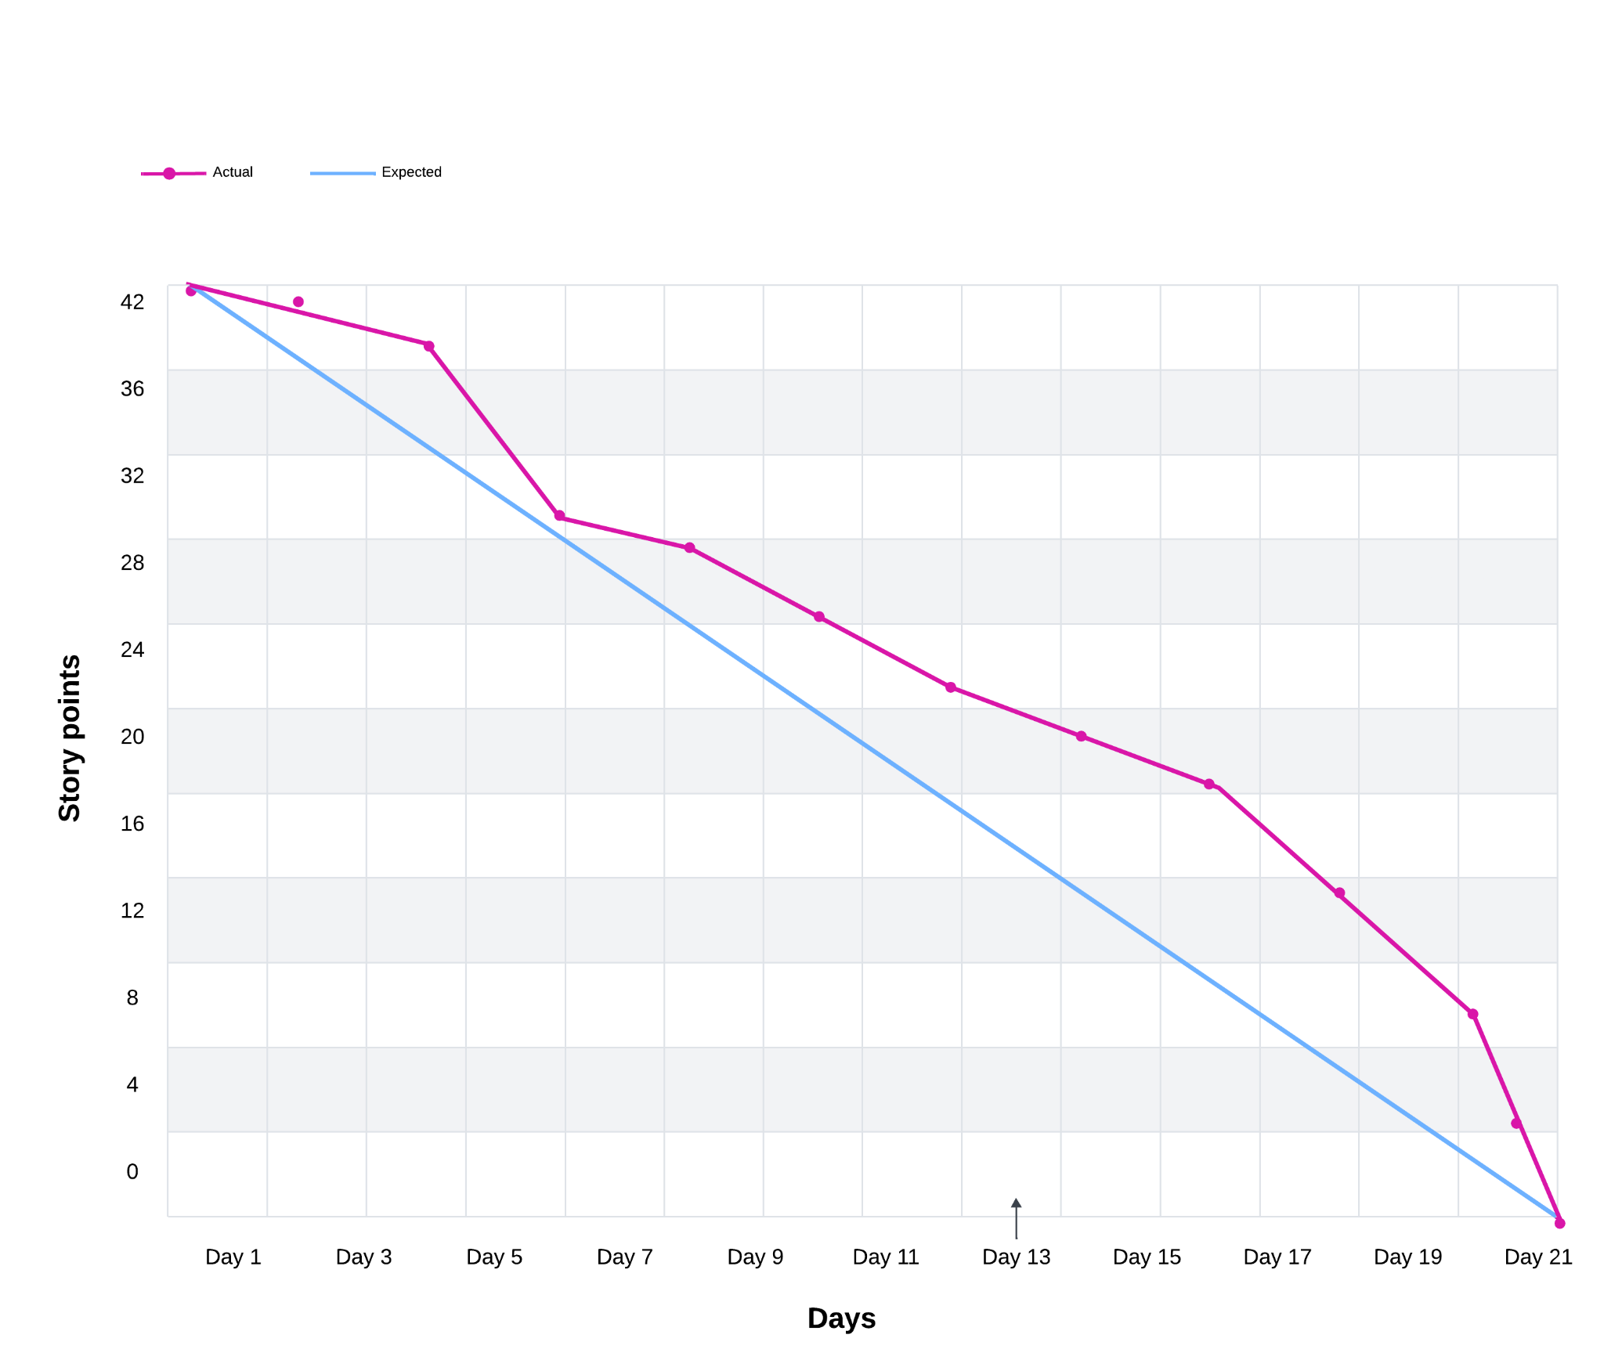
Burn down chart

Slide 48

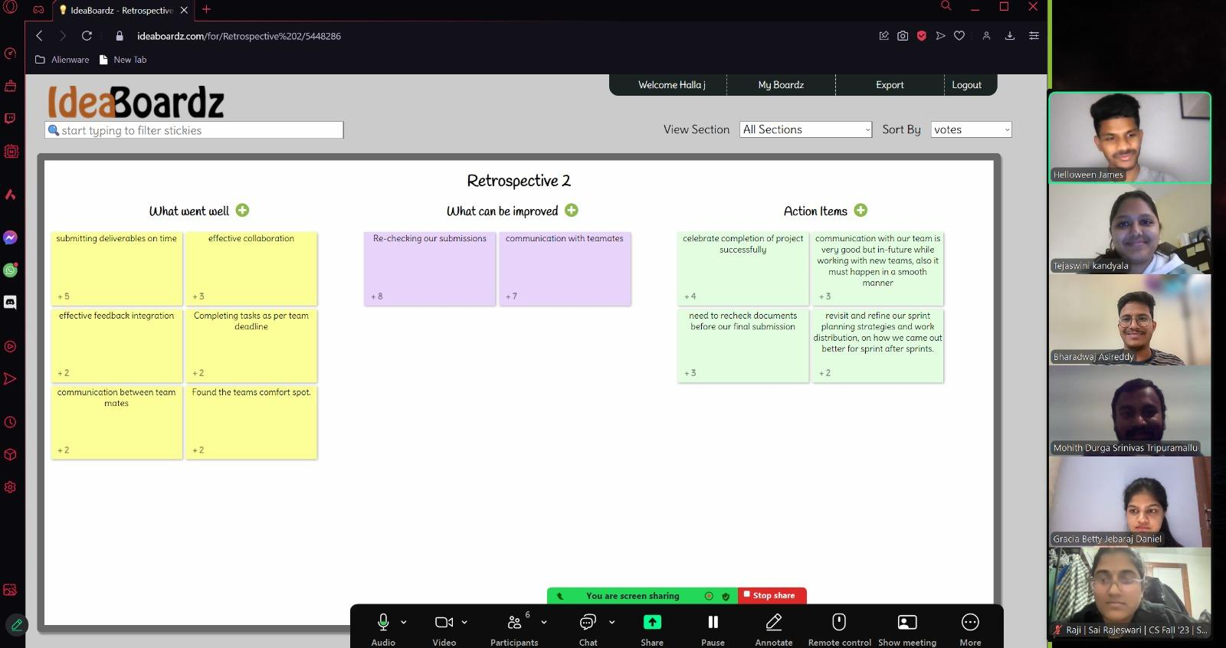
RETROSPECTIVE

Slide 49

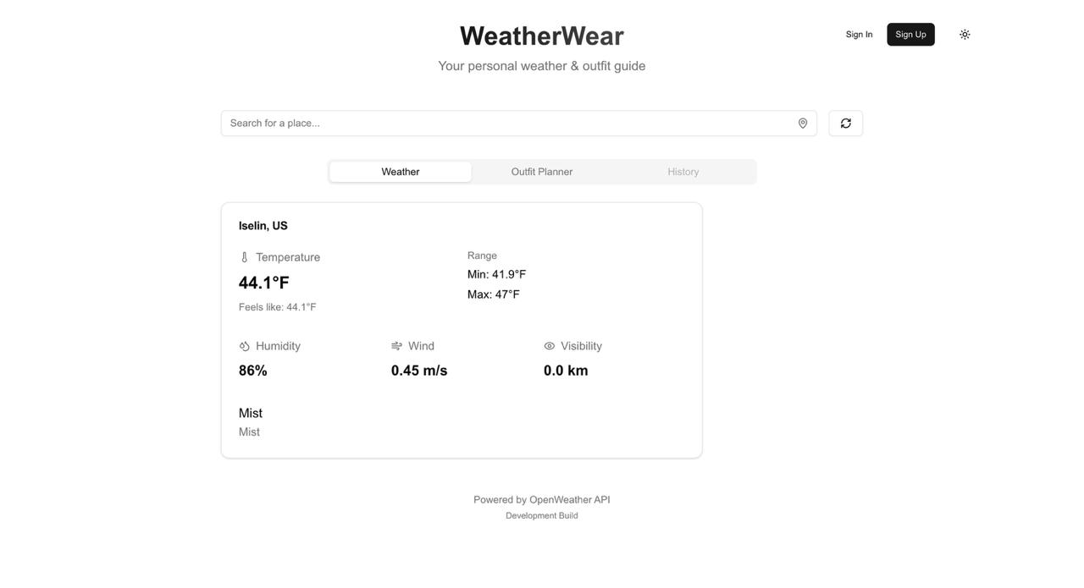
PROJECT DEMO

Slide 50
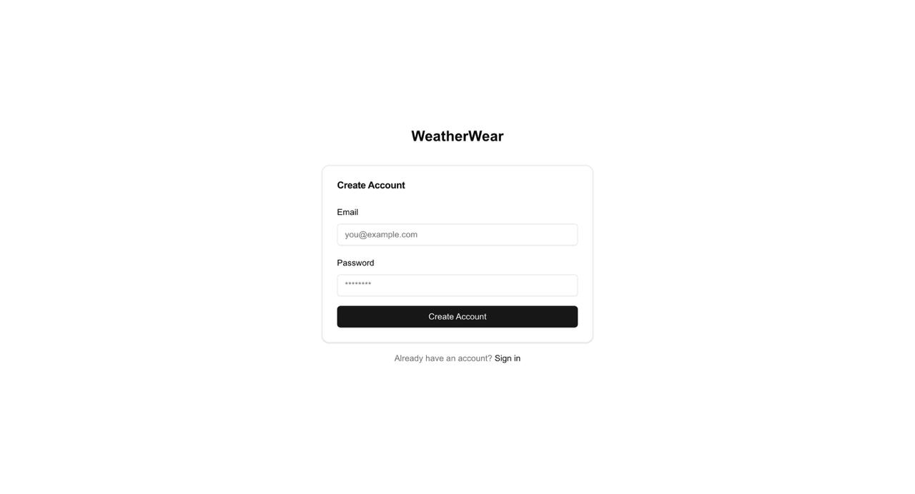
PROJECT DEMO

Slide 51
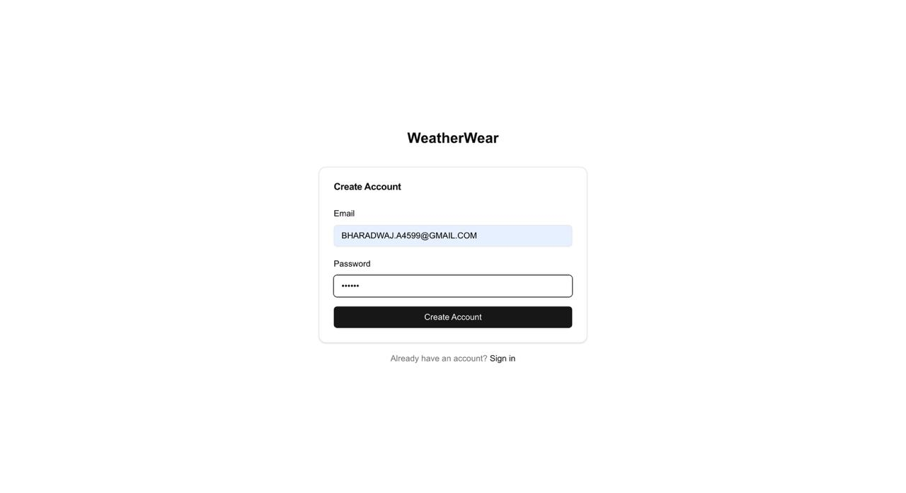
PROJECT DEMO

Slide 52
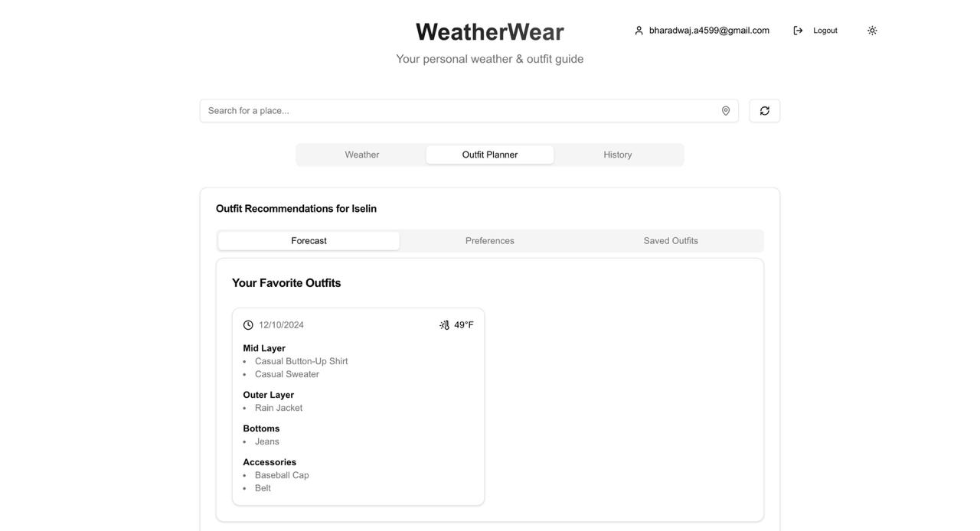
PROJECT DEMO

Slide 53
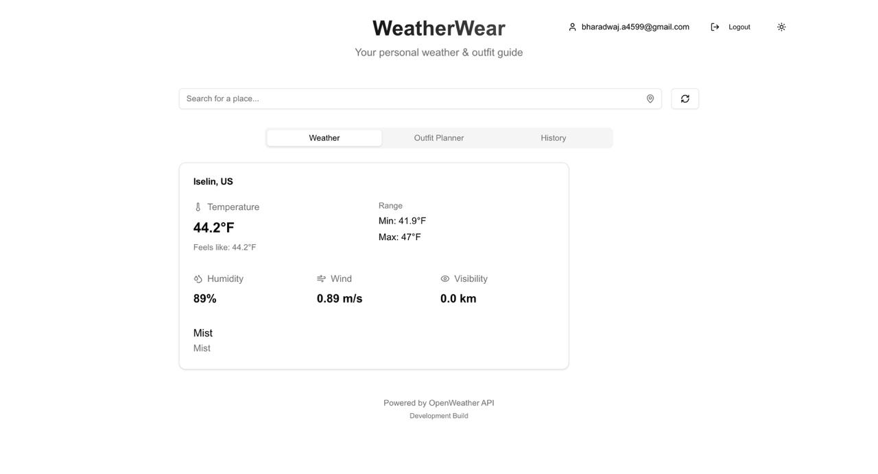
PROJECT DEMO

Slide 54
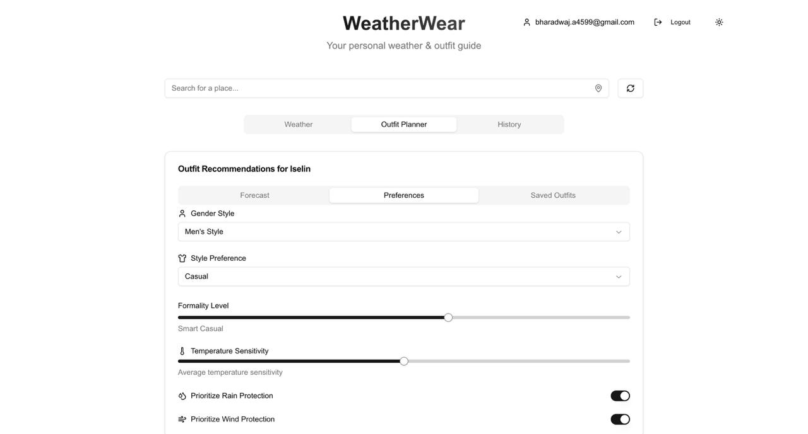
PROJECT DEMO

Slide 55
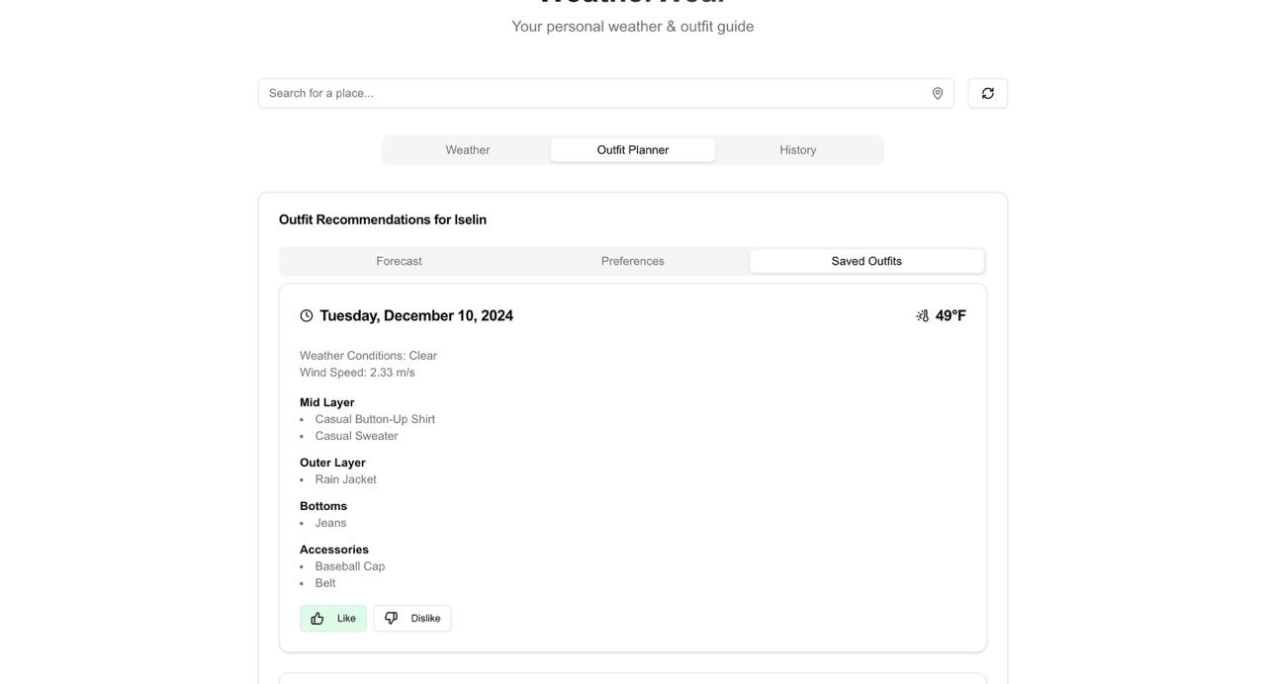
PROJECT DEMO

Slide 56
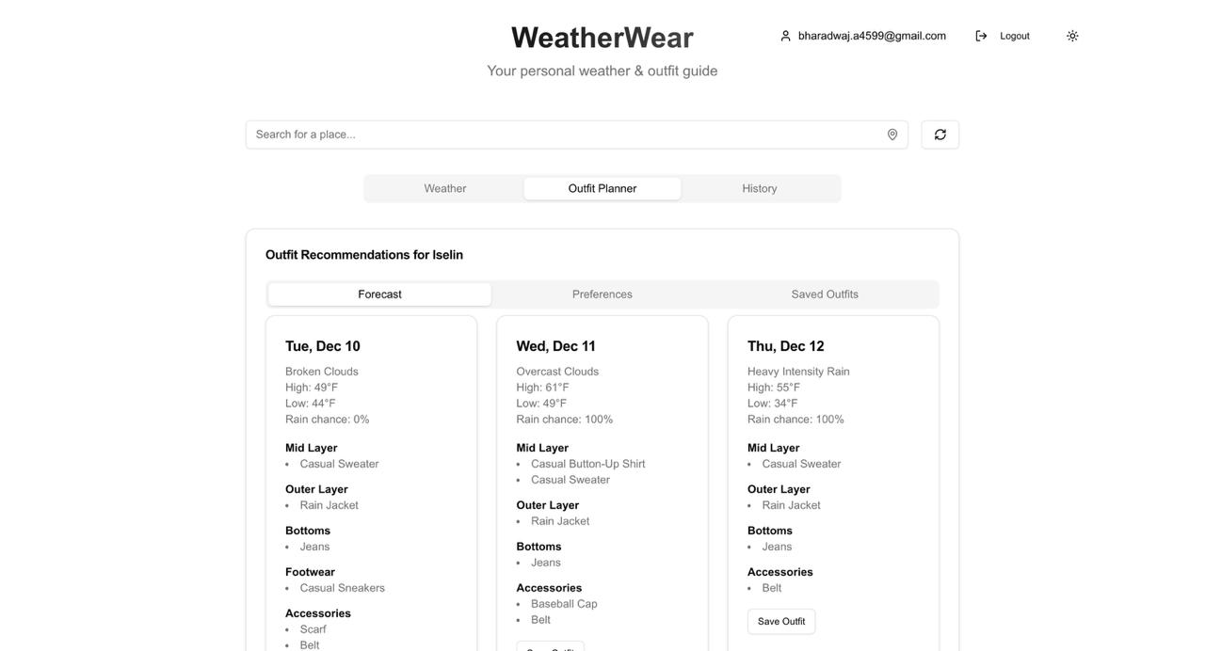
PROJECT DEMO

Slide 57
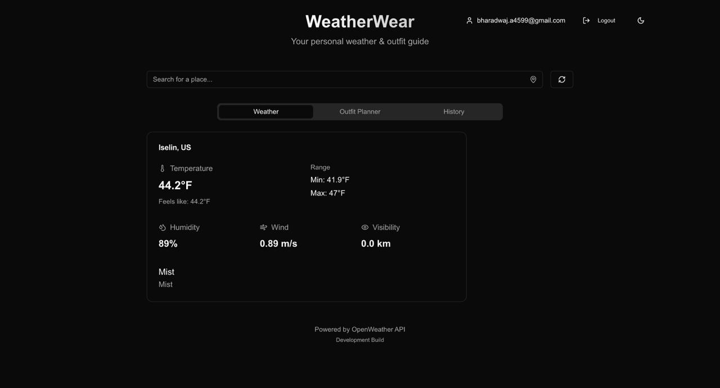
PROJECT DEMO

Slide 58
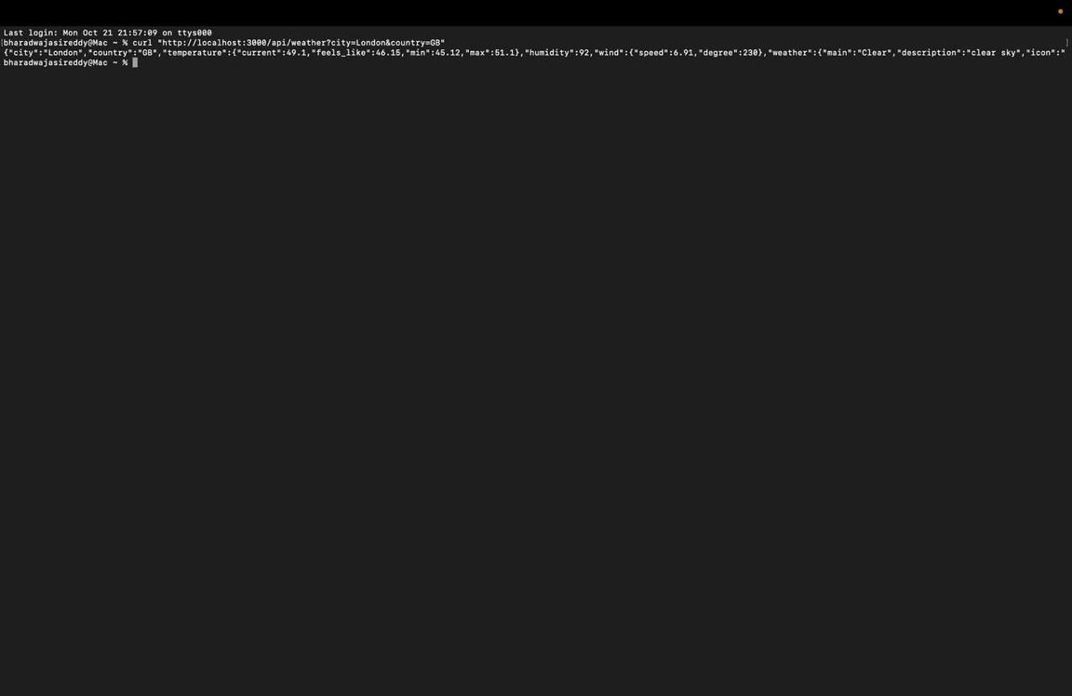
API

Slide 59
GITHUB LINK
https://github.com/htmw/2024F-Bad-Ideas/wiki

Slide 60
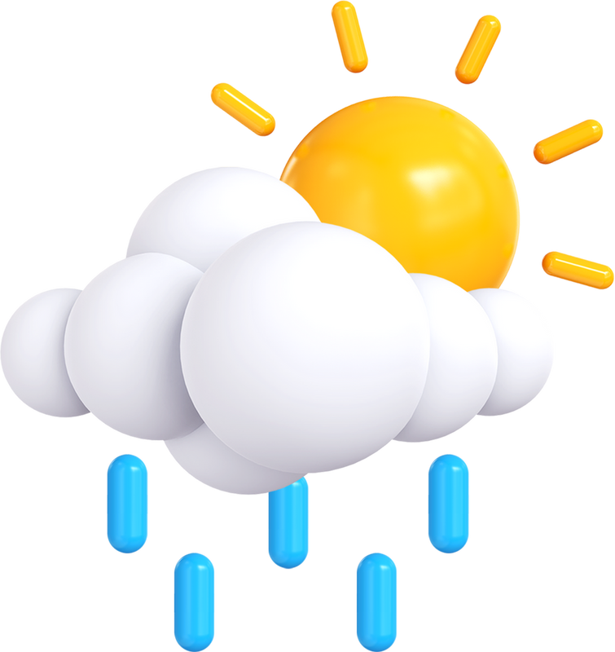
THANK YOU

